Slide 1

Identify this Brand using this Audio
Notes:
Imperial Blue

Slide 2
Identify this Brand using this Audio
Notes:
Hutch

Slide 3
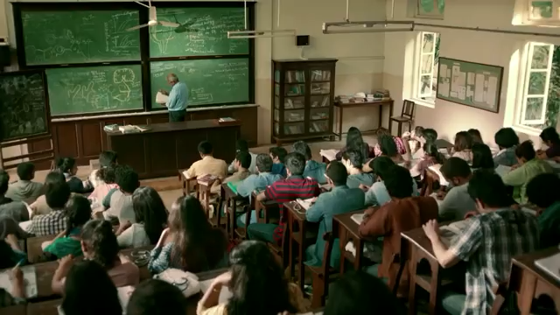
Identify this Brand using this Video
Notes:
Titan

Slide 4
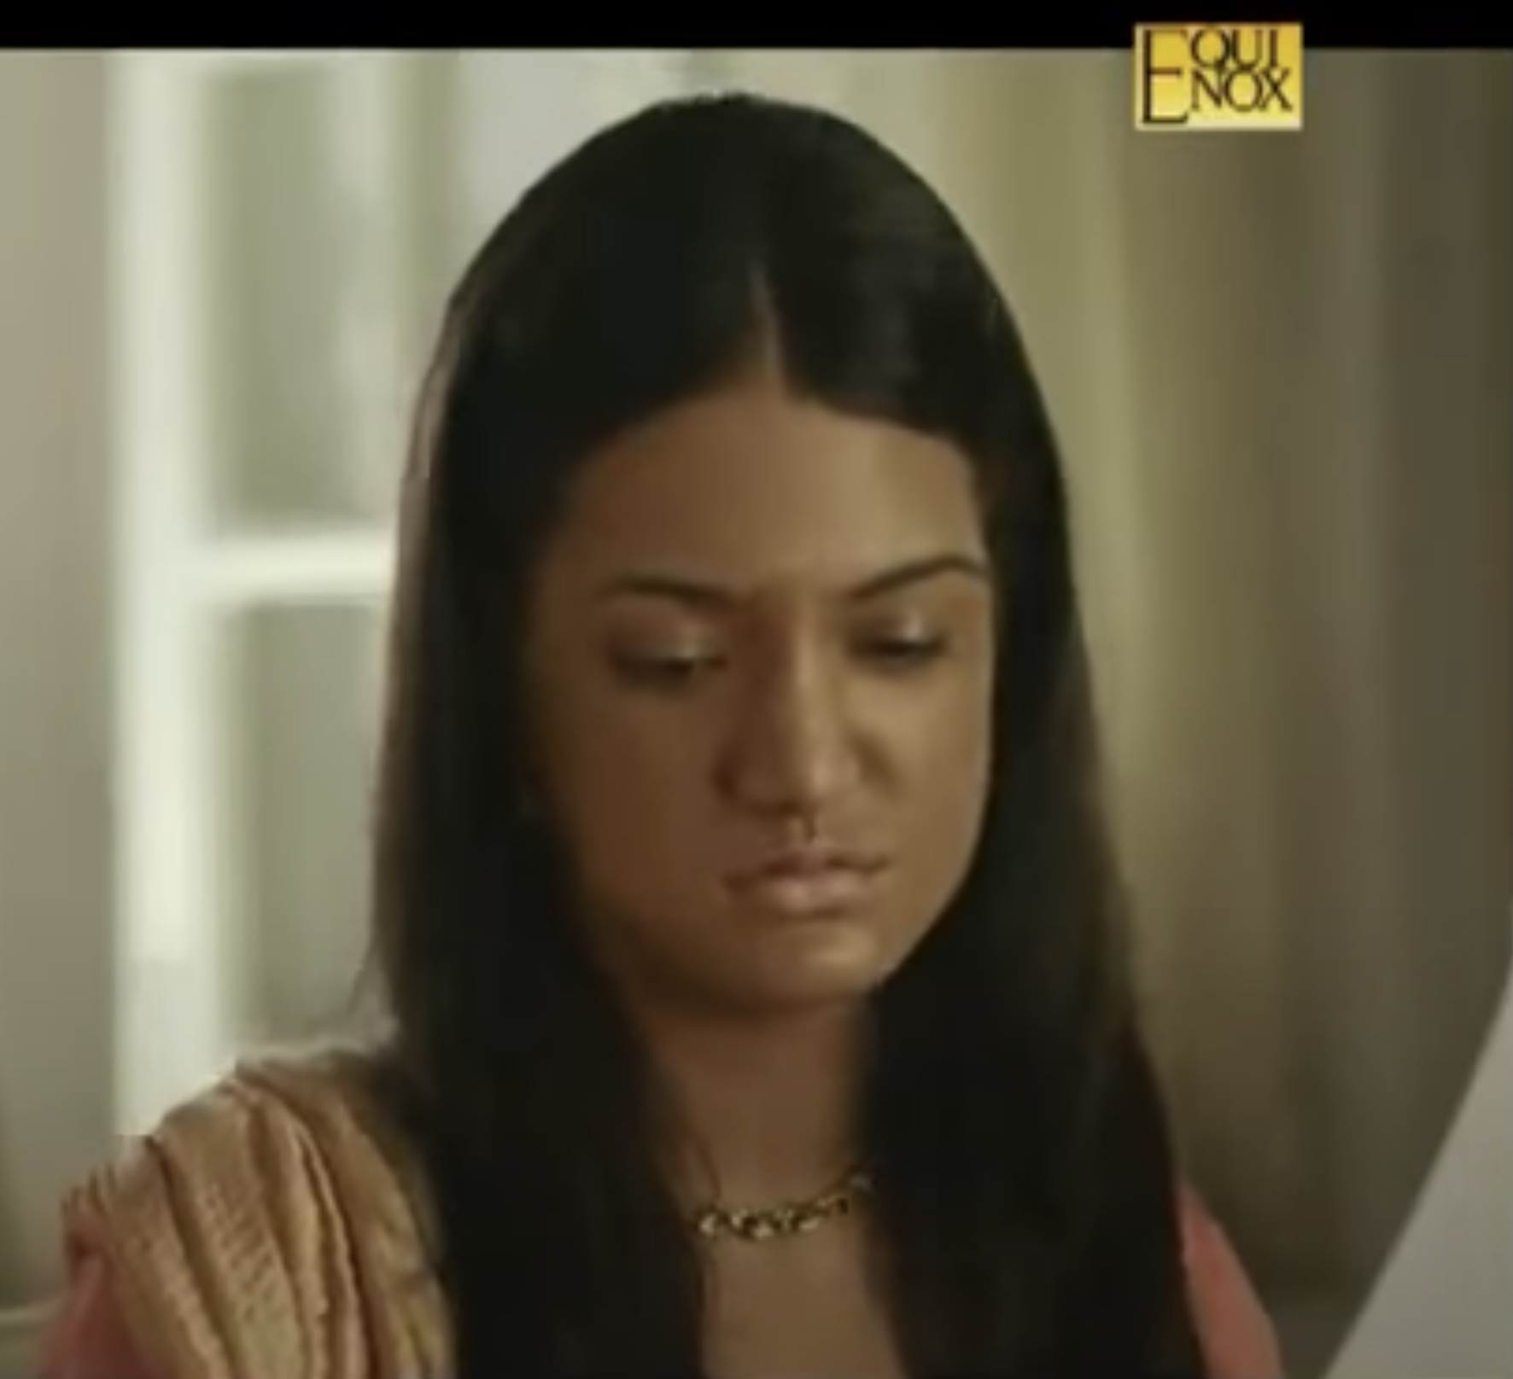
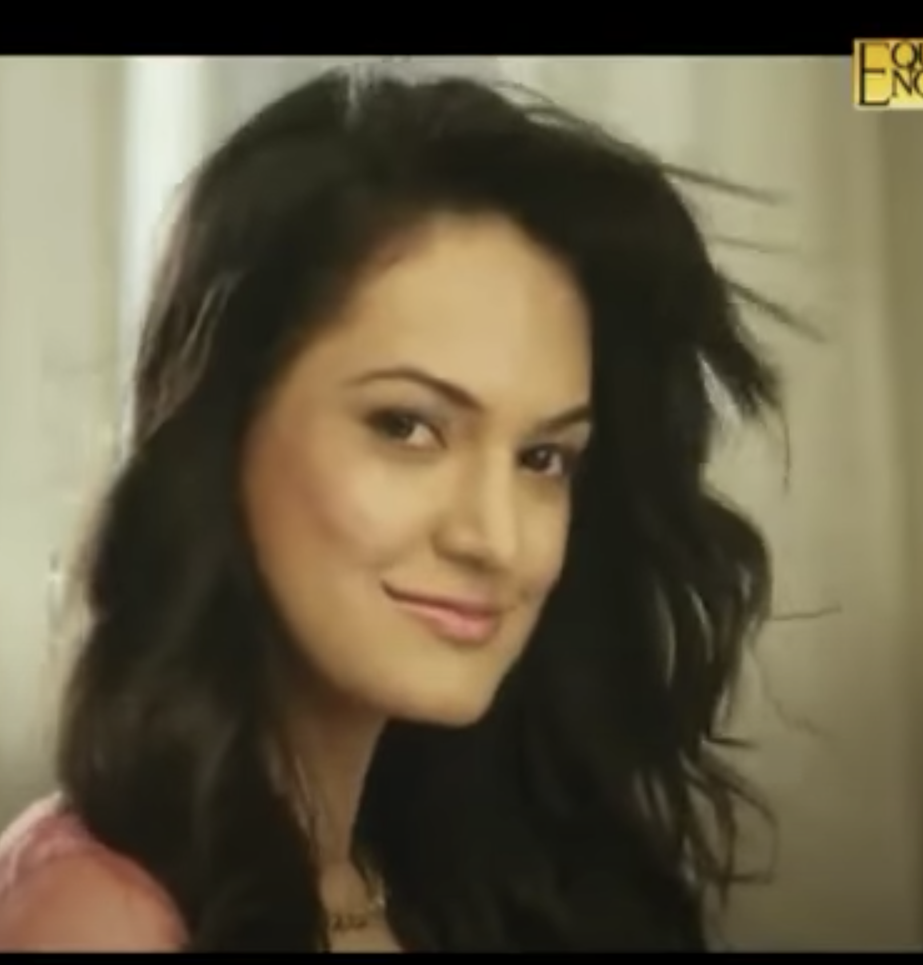
Which product was used to get this Glow!!!?
Notes:
Bajaj CFL light https://www.youtube.com/watch?v=VgwWcieoKuo&ab_channel=MaxiXLRI

Slide 5
IDENTIFY THE BRAND USING THE FAMOUS TAGLINE
KYA CHALRA HAI?? KYA CHALRA HAI??
KYA CHALRA HAI??

Slide 6
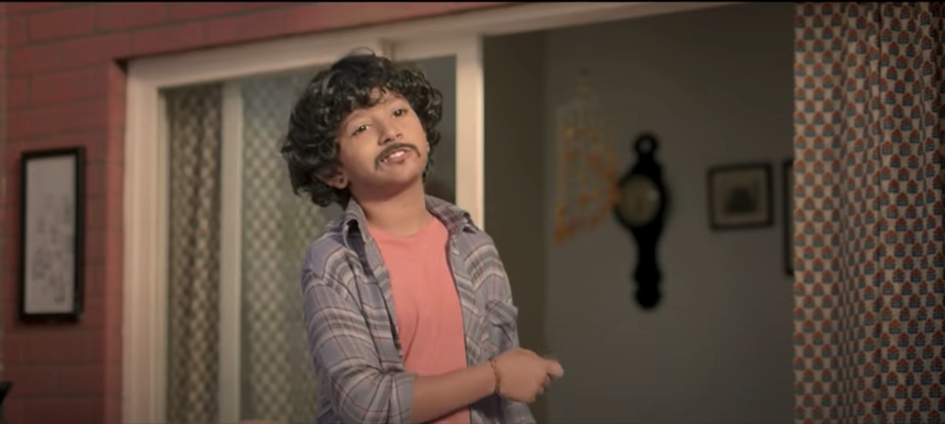
Identify this Brand using this Video

Slide 7
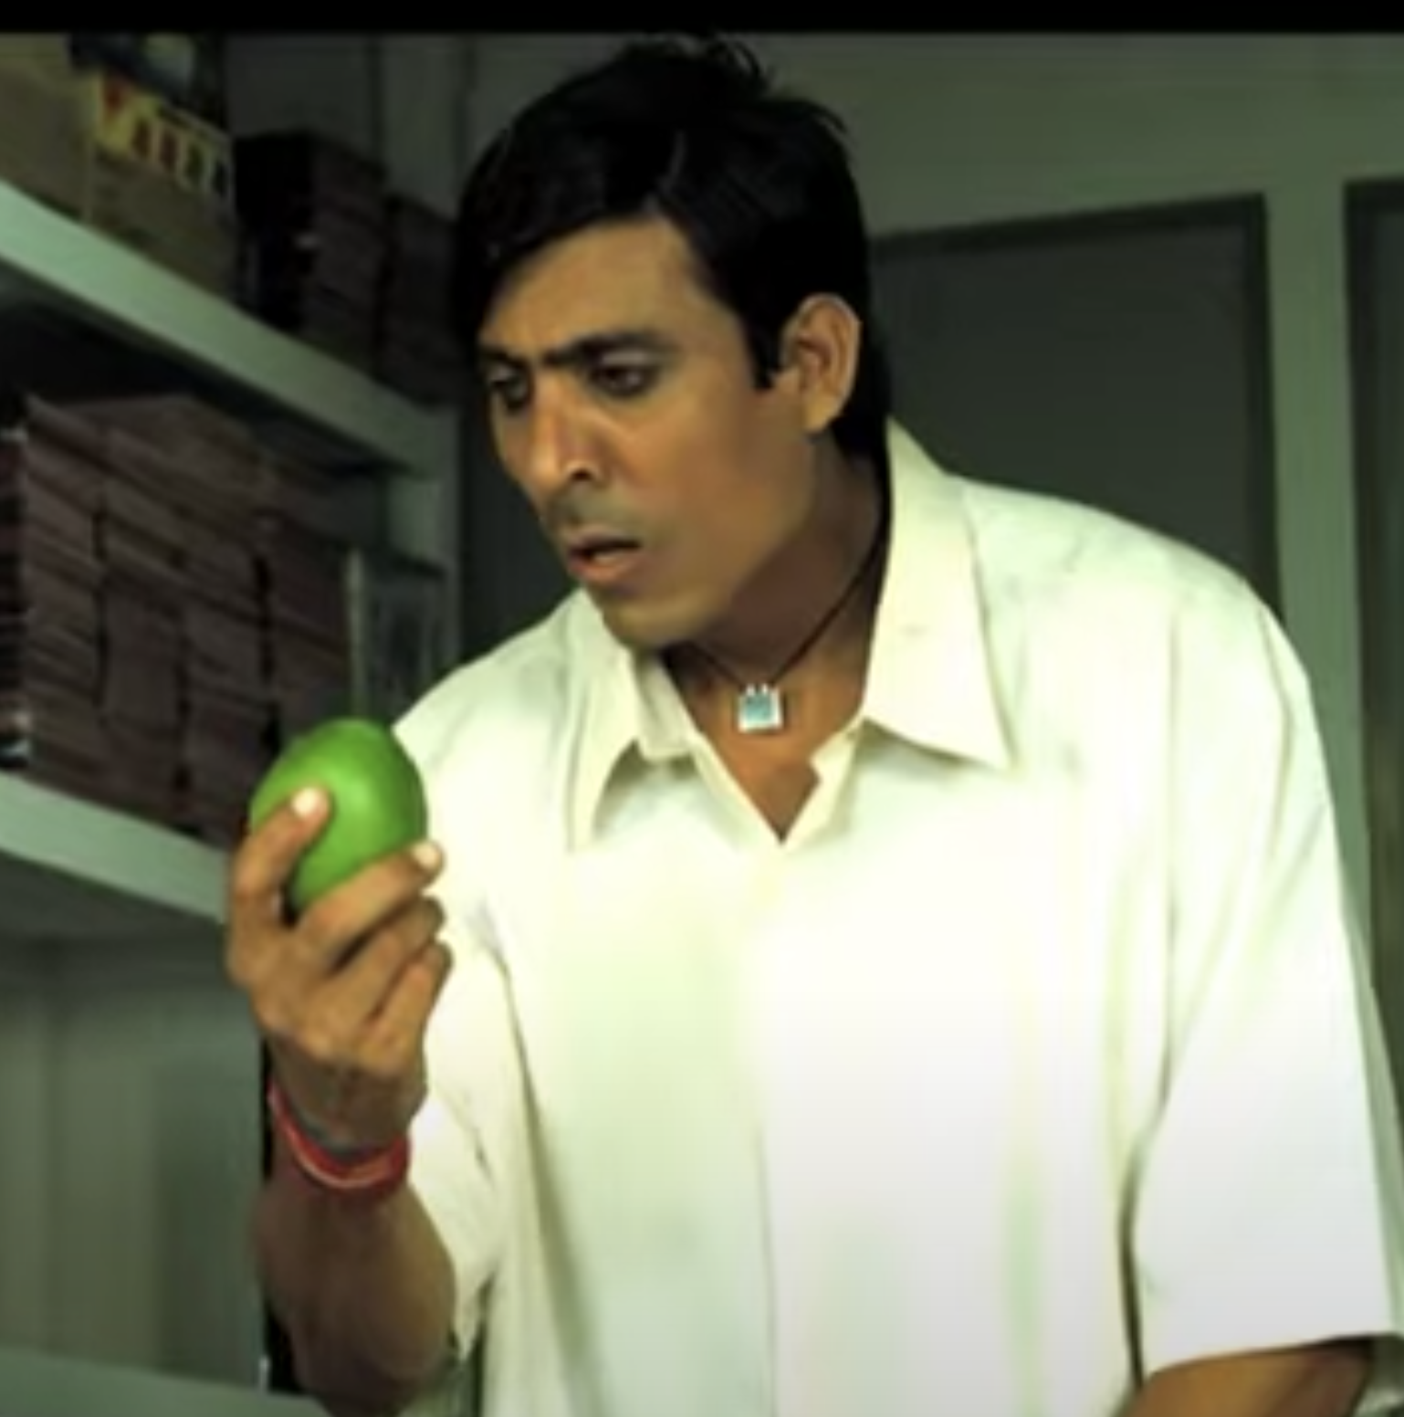
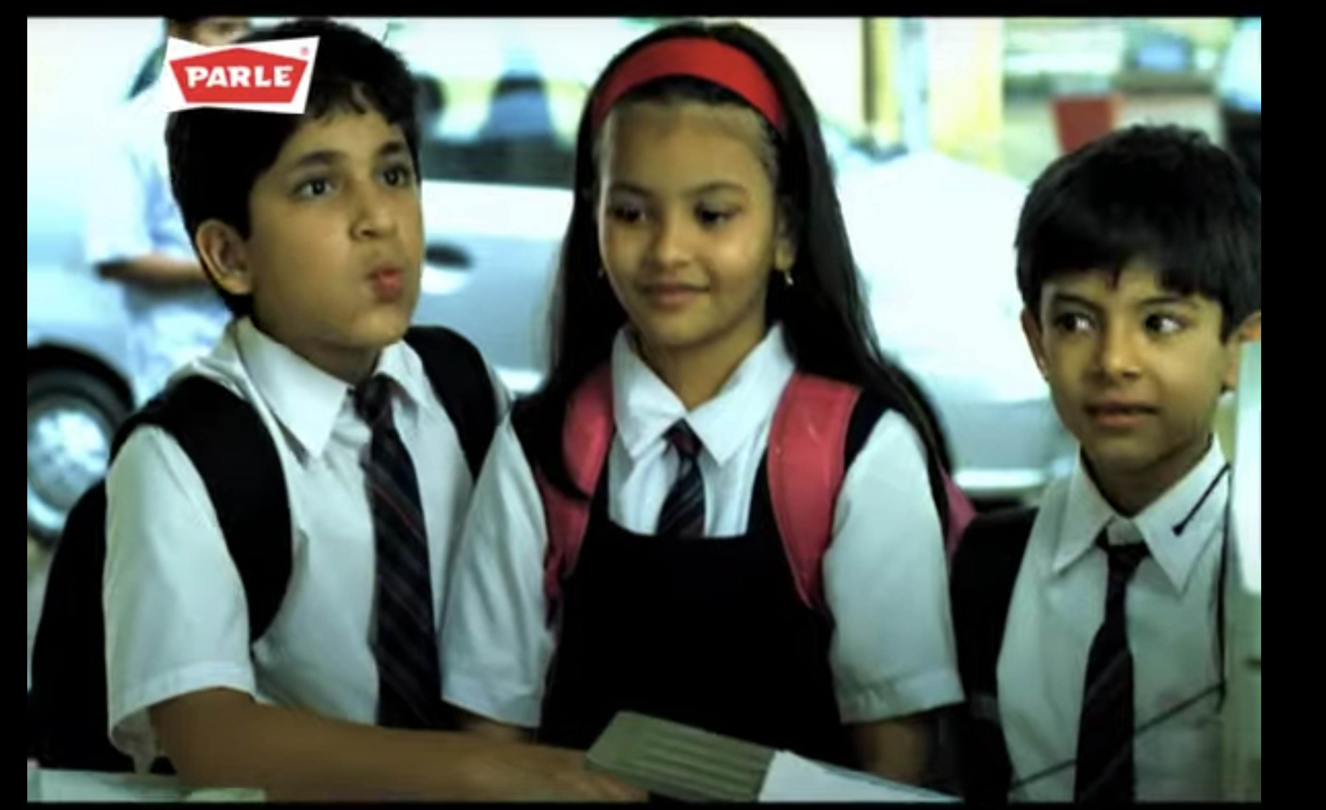
Identify this chocolate add
Notes:
Kacha mango bite

Slide 8
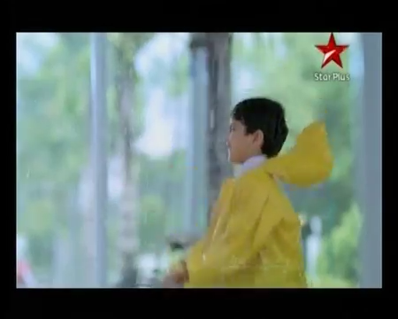
Identify The brand using this video

Slide 9
Identify the product using this Audio
Notes:
Surf excel

Slide 10
Identify the product using this Audio

